Slide 1

Field bioinformatics
ARTIC Network Train the Trainer - August 2022
ARTIC TRAIN 03AUG22 Áine N O'Toole

Slide 2
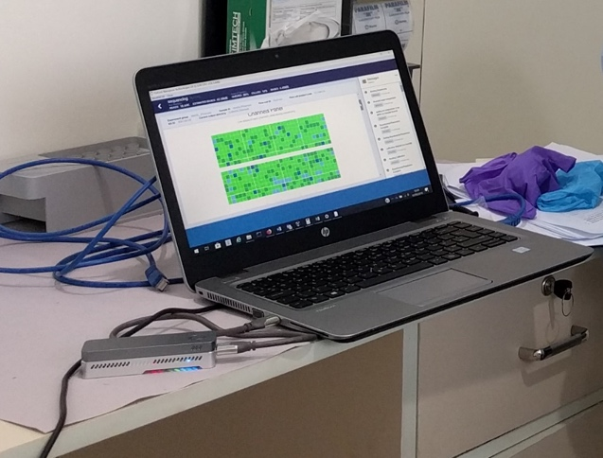

Slide 3
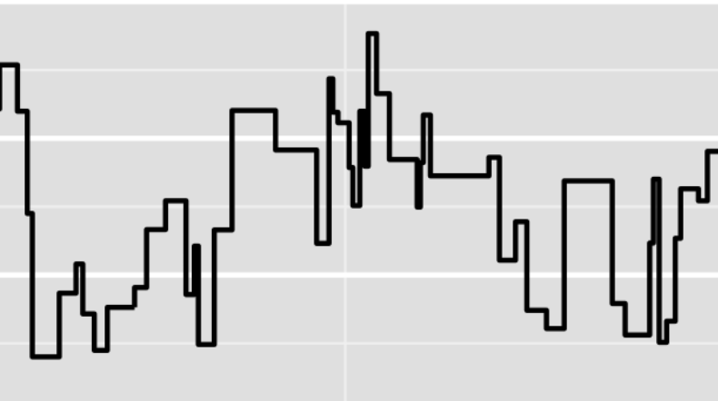
Nanopore bioinformatics
Goal:
> sample01
CTAGCATGCATCGTAGCTAGCTAGCTGATCGATGCTAGTCATGCTAGCTGATGCTAGTCGATGCTGATGCTAGTCGTGATGCTAGTCGATGCTAGTCGTAGCTAGTCGATGCTAGCTA
…
Squiggles
FASTA file

Slide 4
Nanopore bioinformatics
Goal:
>
Sequence name
> sample01
CTAGCATGCATCGTAGCTAGCTAGCTGATCGATGCTAGTCATGCTAGCTGATGCTAGTCGATGCTGATGCTAGTCGTGATGCTAGTCGATGCTAGTCGTAGCTAGTCGATGCTAGCTA
…
Squiggles
Genome sequence
FASTA file

Slide 5

First steps performed by MinKNOW

Slide 6
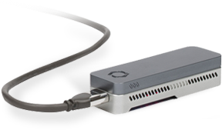
1. Basecalling
ATGCATGC
.fastq
.fast5

Slide 7
@read
ATGCATGC
+
“$##€**’
guppy
ATGCATGC
.fastq
.fast5
1. Basecalling

Slide 8
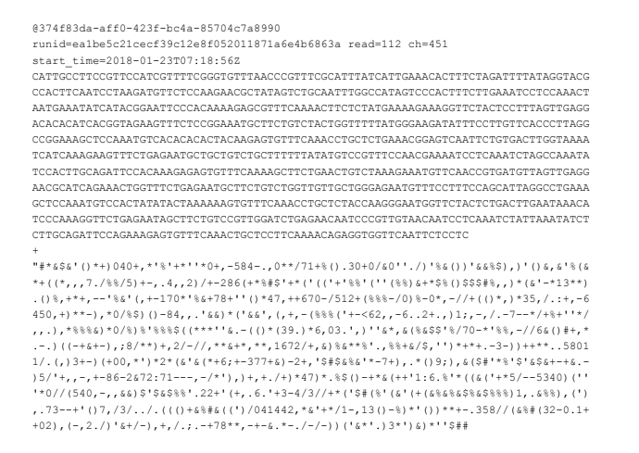
FASTQ

Slide 9
FASTQ
header

Slide 10
FASTQ
header

Slide 11
FASTQ
header
channel
@
unique read id
run id
read no.
start time in pore

Slide 12
FASTQ
nucleotide bases

Slide 13
FASTQ
quality information

Slide 14
FASTQ
header
nt bases
spacer
quality
Notes:
So four lines

Slide 15
Anatomy of a MinION read
Notes:
To explain the next step we need to know a little bit about what are the different parts of information stored in each sequencing read. For nanopore data, if we work backwords in the wet lab protocol steps we can identify the parts of the read that exist in our data

Slide 16
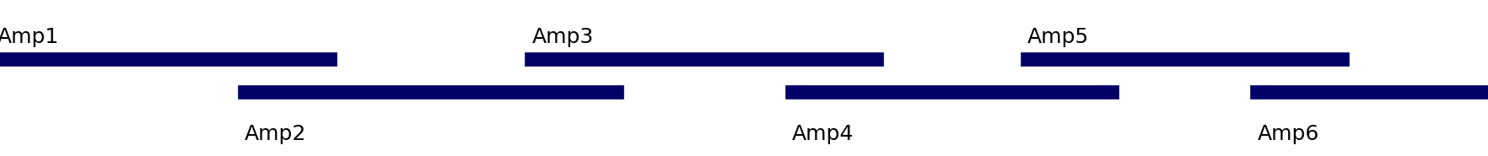
Tiled amplicon scheme
Notes:
And remember we’re talking about tiled amplicon schemes here using the ligation kit for nanopore. This is specific to the artic scheme and won’t necessarily directly correspond to other seq techs or protocols

Slide 17
Tiled amplicon scheme
Notes:
The amplicons themselves are only a part of the reads.

Slide 18
Adaptors
Notes:
Adaptors are the last things that get added before the sequencing run so they’re on the ends

Slide 19
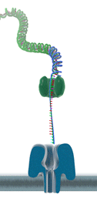
Adaptors
Notes:
Little bits of DNA with a protein ligated to it

Slide 20
Barcodes
Notes:
Again working backwords through the wet-lab protocol, barcodes were added

Slide 21
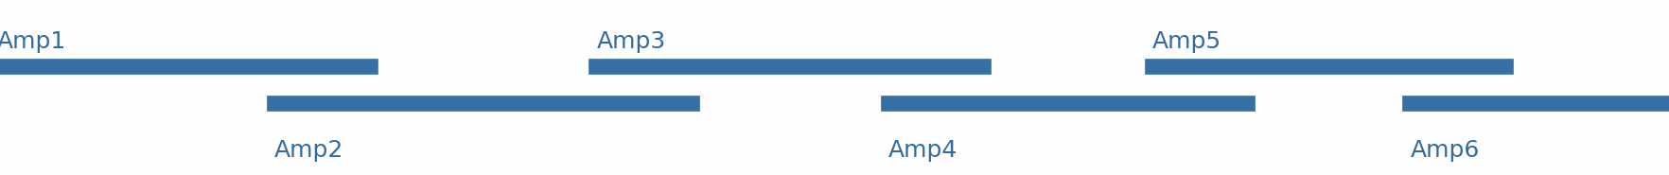
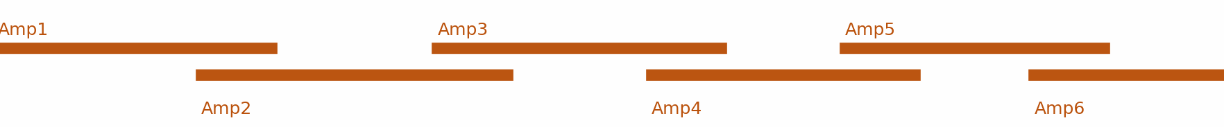
Barcodes
Sample 1
Sample 2
Sample 3
Notes:
Barcodes are little unique nucleotide sequences that get stuck on to each sample- so the barcode sequence allows you to id which sample each read is from

Slide 22
Notes:
And because everything gets pooled together for nanopore data, we’ve got all our samples in one tube, the reads that get produced are a mixture

Slide 23
2. Demultiplexing
Notes:
And identifying what barcodes are part of what sample is called demultiplexing

Slide 24
guppy
barcode01
barcode02
2. Demultiplexing
Unassigned

Slide 25
barcode01
barcode02
basecalling
demultiplexing
Unassigned
Notes:
In summary, the data you get out of minknow will be basecalled and demultiplexed. But we still have a long way to go to get to the final fasta sequence file

Slide 26

ARTIC Network Field Bioinformatics

Slide 27
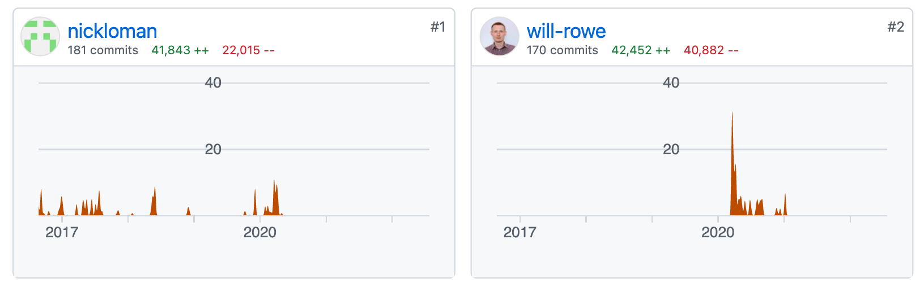
ARTIC Network Field Bioinformatics
Notes:
Created by nick loman in 2016 and then was updated extensively in 2020 at the start of the sarscov-2 pandemic by will rowe

Slide 28
> sample01
CTAGCATGCATCGTAGCTAGCTAGCTGATCGATGCTAGTCATGCTAGCTGATGCTAGTCGATGCTGATGCTAGTCGTGATGCTAGTCGATGCTAGTCGTAGCTAGTCGATGCTAGCTA
…
ARTIC Network Field Bioinformatics
FASTA file

Slide 29
Best practice bioinformatic pipeline
ARTIC Network Field Bioinformatics

Slide 30
Best practice bioinformatic pipeline
For tiled amplicon schemes
ARTIC Network Field Bioinformatics

Slide 31
Best practice bioinformatic pipeline
For tiled amplicon schemes
Command line tool or …
ARTIC Network Field Bioinformatics

Slide 32

ARTIC Network Field Bioinformatics
Notes:
It has also been implemented in epi2me which is an interface for running pipelines that nanopore provide.

Slide 33
barcode01
ARTIC Network Field Bioinformatics
Notes:
So because of minknow we have directories on the computer with lots of reads for each barcode.

Slide 34
barcode01
ARTIC Network Field Bioinformatics
Notes:
The reads still have stuff of on the end that we don’t want contributing to our end sequence.

Slide 35
?
barcode01
ARTIC Network Field Bioinformatics
Notes:
We also want to make sure that the actual stuff in the sequence is what we think it is, so figure out if it’s sars-cov-2, and also figure out what part of the genome it corresponds to

Slide 36
align_trim
ARTIC Network Field Bioinformatics
Notes:
So this is what one of the first stages of the pipeline does- called align trim

Slide 37
Align to reference
Reference genome
Pool 1
Pool 2
Notes:
In order to find out what parts of the reads correspond to what parts of the genome we align against the reference- ref on top, example of the amplicons we’re expecting to see based on our lab protocol. Remember there are two pools of primers.

Slide 38
Align to reference
Reference genome

Slide 39
Notes:
If we revisit the anatomy of a read

Slide 40
Adaptors
Notes:
Adaptors are the last things that get added before the sequencing run so they’re on the ends

Slide 41
Barcodes
Notes:
Again working backwords through the wet-lab protocol, barcodes were added

Slide 42
Primers
Notes:
The next thing is the primer sequences- which will be identical to the reference, so we don’t want to include these in our final output either

Slide 43
Sequence of interest
Notes:
So it’s really the middle bit highlighted here is what we’re interested in getting out at the end

Slide 44
Align to reference
Reference genome

Slide 45
Reference genome
If it does not align:
Low quality read
Contamination (human?)

Slide 46
Reference genome
Throw them away
If it does not align:
Low quality read
Contamination (human?)

Slide 47
Reference genome
Amplicon 2
Read Group 2

Slide 48
Reference genome
Reads assigned an
-amplicon
-read group
based on where they align

Slide 49
Reference genome
This alignment process produces a map of where along the genome the reads belong
SAM (sequence alignment map)

Slide 50
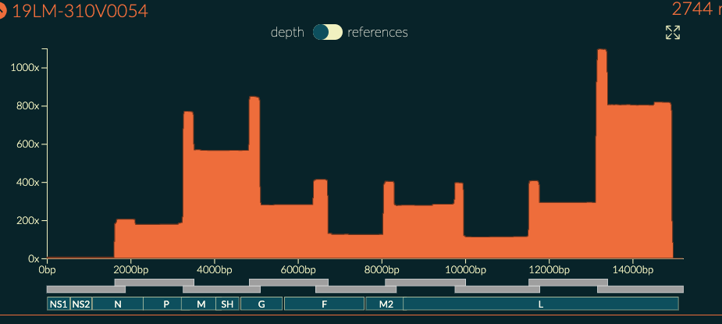
Coverage
Amplicon
Overlap = double coverage

Slide 51
SAM (sequence alignment map)
@HD VN:1.3 SO:coordinate
@SQ SN:ref LN:45
@SQ SN:ref2 LN:40
r001 163 ref 7 30 8M4I4M1D3M = 37 39 TTAGATAAAGAGGATACTG * XX:B:S,12561,2,20,112
r002 0 ref 9 30 1S2I6M1P1I1P1I4M2I * 0 0 AAAAGATAAGGGATAAA *
r003 0 ref 9 30 5H6M * 0 0 AGCTAA *
r004 0 ref 16 30 6M14N1I5M * 0 0 ATAGCTCTCAGC *
r003 16 ref 29 30 6H5M * 0 0 TAGGC *
r001 83 ref 37 30 9M = 7 -39 CAGCGCCAT *

Slide 52
SAM (sequence alignment map)
Header information
@HD VN:1.3 SO:coordinate
@SQ SN:ref LN:45
@SQ SN:ref2 LN:40
r001 163 ref 7 30 8M4I4M1D3M = 37 39 TTAGATAAAGAGGATACTG * XX:B:S,12561,2,20,112
r002 0 ref 9 30 1S2I6M1P1I1P1I4M2I * 0 0 AAAAGATAAGGGATAAA *
r003 0 ref 9 30 5H6M * 0 0 AGCTAA *
r004 0 ref 16 30 6M14N1I5M * 0 0 ATAGCTCTCAGC *
r003 16 ref 29 30 6H5M * 0 0 TAGGC *
r001 83 ref 37 30 9M = 7 -39 CAGCGCCAT *
Alignment information

Slide 53
Reference genome
Mask out the part of the read we don’t want
Softmasking

Slide 54
Reference genome
trimmed
primer trimmed

Slide 55
Coverage
Amplicon
Overlap = double coverage

Slide 56
Normalise coverage across genome
Coverage

Slide 57
Sequence of interest
Notes:
But it’s not quite as straightforward as that, we have the part of the read we care about,

Slide 58
Sequence of interest (with error)
Notes:
But Because of the error rate of nanopore, each read will have a proportion of unique errors

Slide 59
Sequence of interest (with error)
SNPs
Deletions
Insertions
Notes:
These can be point mutations or snps, deletions and insertions.

Slide 60
Nanopore error is biased towards
Homopolymers
Low complexity regions
Notes:
These can be point mutations or snps, deletions and insertions.

Slide 61
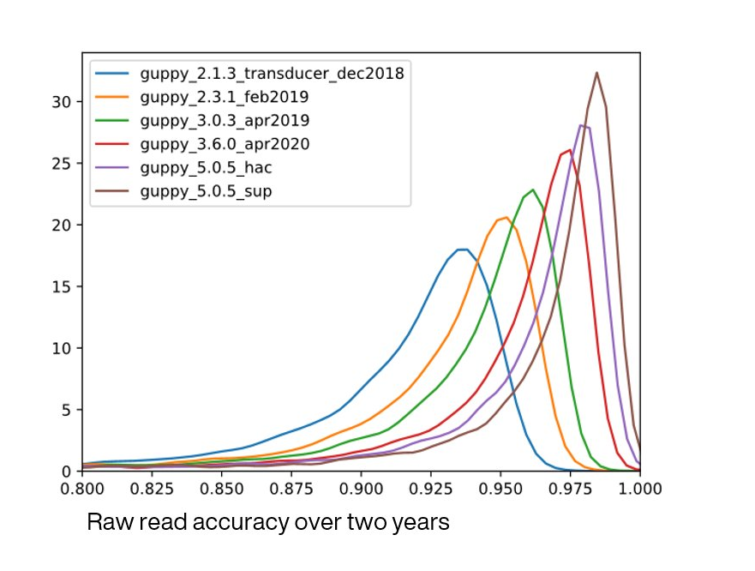
Nanopore error is biased towards
Homopolymers
Low complexity regions
Notes:
These can be point mutations or snps, deletions and insertions.

Slide 62
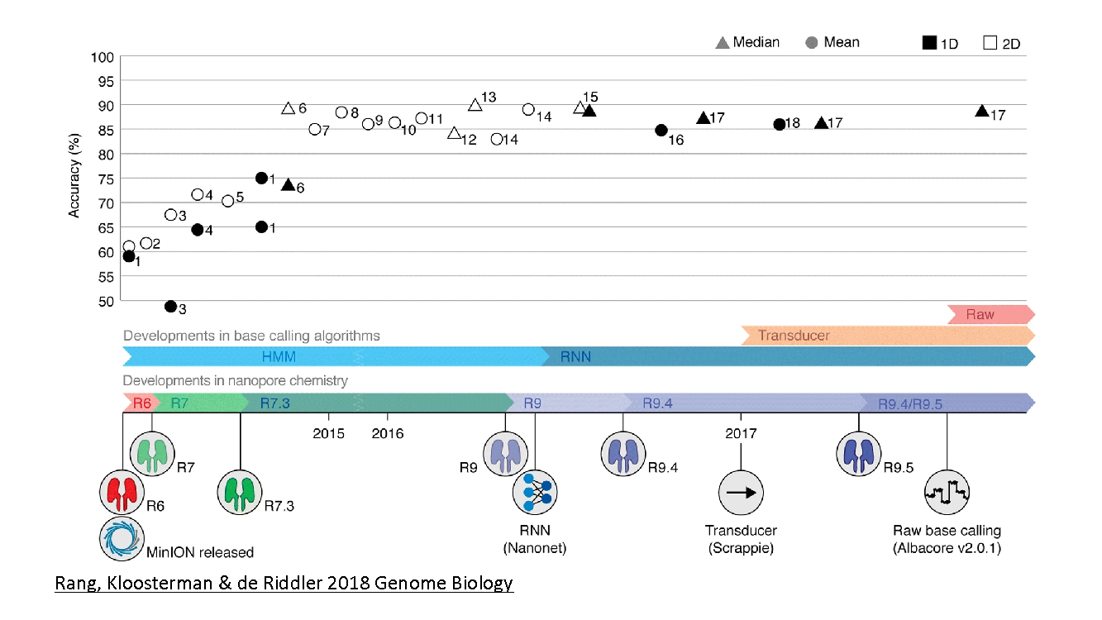

Slide 63
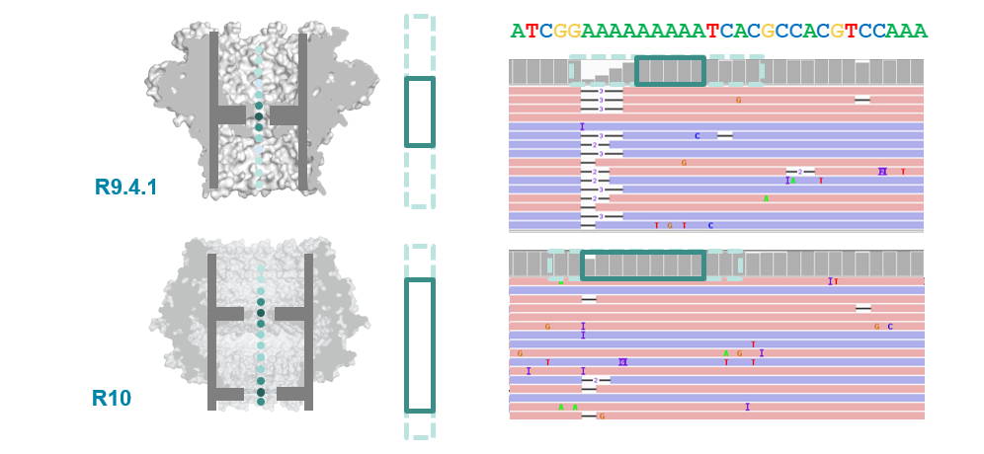
nanoporetech.com
95-97% 1D single molecule accuracy

Slide 64
Sequence of interest (with error)
Notes:
So it is getting better, but

Slide 65
Notes:
But they’ll be different between different reads

Slide 66
Sufficient depth & coverage
Notes:
But they’ll be different between different reads

Slide 67
Call variants
Variant called

Slide 68
Reference genome

Slide 69
Reference genome
Read Group 1
Read Group 2

Slide 70
Call variants Read Group 1
Reference genome

Slide 71
Call variants Read Group 2
Reference genome

Slide 72
Reference genome
Merge variants from the two read groups together

Slide 73
Quality check all variants called
Coverage

Slide 74
Quality check all variants called
Coverage
Coverage too low

Slide 75
Quality check all variants called
Depth mask
Coverage
Coverage too low

Slide 76
Reference genome
Call consensus sequence (bcftools)

Slide 77
Recap
Basecalling
Demultiplexing
Align vs reference
Mask unwanted part of reads
Normalise depth
Call variants (RG1 and RG2)
Merge variants
QC filter variants
Mask low depth of coverage
Call consensus

Slide 78
